Slide 1
Introduction to Data Analysis

Slide 2
DATA PROCESSING & DATA CLEANING
Patrick Boily Data Action Lab | uOttawa | Idlewyld Analytics
pboily@uottawa.ca

Slide 3
DATA CLEANING
“Obviously, the best way to treat missing data is not to have any.”
T. Orchard, M. Woodbury
“The most exciting phrase to hear, the one that heralds the most discoveries, is not “Eureka!” but “That's funny…”.”
I. Asimov
DATA PROCESSING

Slide 4
FOUR VERY IMPORTANT REMARKS
NEVER work on the original dataset. Make copies along the way.
Document ALL your cleaning steps and procedures.
If you find yourself cleaning too much of your data, STOP. Something might be off with the data collection procedure.
Think TWICE before discarding an entire record.

Slide 5
APPROACHES TO DATA CLEANING
There are two philosophical approaches to data cleaning and validation:
methodical
narrative
The methodical approach consists of running through a check list of potential issues and flagging those that apply to the data.
The narrative approach consists of exploring the dataset and trying to spot unlikely and irregular patterns.

Slide 6
PROS AND CONS
Methodical (syntax)
Pros: checklist is context-independent; pipelines easy to implement; common errors and invalid observations easily identified
Cons: may prove time-consuming; cannot identify new types of errors
Narrative (semantics)
Pros: process may simultaneously yield data understanding; false starts are (at most) as costly as switching to mechanical approach
Cons: may miss important sources of errors and invalid observations for datasets with high number of features; domain knowledge may bias the process by neglecting uninteresting areas of the dataset

Slide 7
TOOLS AND METHODS
Methodical
list of potential problems (Data Cleaning Bingo)
code which can be re-used in different contexts
Narrative
visualization
data summary
distribution tables
small multiples
data analysis

Slide 8
Data Cleaning Bingo

Slide 9
APPROACHES TO DATA CLEANING
The narrative approach is akin to working out a crossword puzzle with a pen and putting down potentially wrong answers occasionally, to see where that takes you.
The mechanical approach is akin to working it out with a pencil, a dictionary, and never jotting down an answer unless you are certain it is correct.
You’ll solve more puzzles (and it will be flashier) the first way, but you’ll rarely be wrong the second way.
It’s the same thing with data: analysts must be comfortable with both approaches.

Slide 10
TYPES OF MISSING OBSERVATIONS
Blank fields come in 4 flavours:
Nonresponse an observation was expected but none had been entered
Data Entry Issue an observation was recorded but was not entered in the dataset
Invalid Entry an observation was recorded but was considered invalid and has been removed
Expected Blank a field has been left blank, but expectedly so
Too many missing values (of the first three type) can be indicative of issues with the data collection process (more on this later); too many missing values (of the fourth type) can be indicative of poor questionnaire design.

Slide 11
THE CASE FOR IMPUTATION
Not all analytical methods can easily accommodate missing observations – 2 options:
Discard the missing observation
not recommended, unless the data is missing completely randomly in the dataset as a whole
acceptable in certain situations (such as a small number of missing values in a large dataset)
Come up with a replacement (imputation) value
main drawback: we never know what the true value would have been
often the best available option

Slide 12
MISSING VALUE MECHANISMS
Missing Completely at Random (MCAR)
item absence is independent of its value or of auxiliary variables
Missing at Random (MAR)
item absence is not completely random; can be accounted by auxiliary variables with complete info
Not Missing at Random (NMAR)
reason for nonresponse is related to item value (also called non-ignorable non-response)

Slide 13
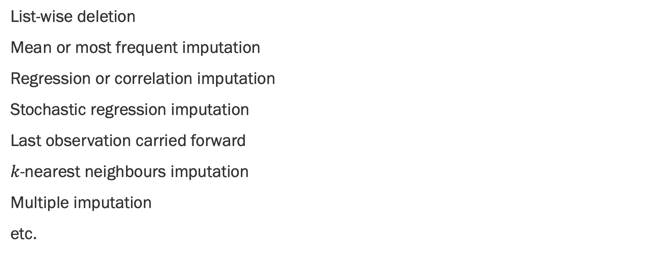
IMPUTATION METHODS
List-wise deletion
Mean or most frequent imputation
Regression or correlation imputation
Stochastic regression imputation
Last observation carried forward
$k$-nearest neighbours imputation
Multiple imputation
etc.

Slide 14
IMPUTATION METHODS
List-wise deletion: remove units with at least one missing values.
Assumption: MCAR
Cons: can introduce bias (if not MCAR), reduction in sample size, increase in standard error
Mean or Most Frequent Imputation: substitute missing values by average value or most frequent value
Assumption: MCAR
Cons: distortions of distribution (spike at mean) and relationships among variables

Slide 15
IMPUTATION METHODS
Regression or Correlation Imputation: substitute missing values by using regression based on other variables (with complete information)
Assumption: MAR
Cons: artificial reduction in variability, over-estimation of correlation
Stochastic Regression Imputation: regression imputation with random error terms added
Assumption: MAR
Cons: increased risk of type I error (false positives) due to small std error

Slide 16
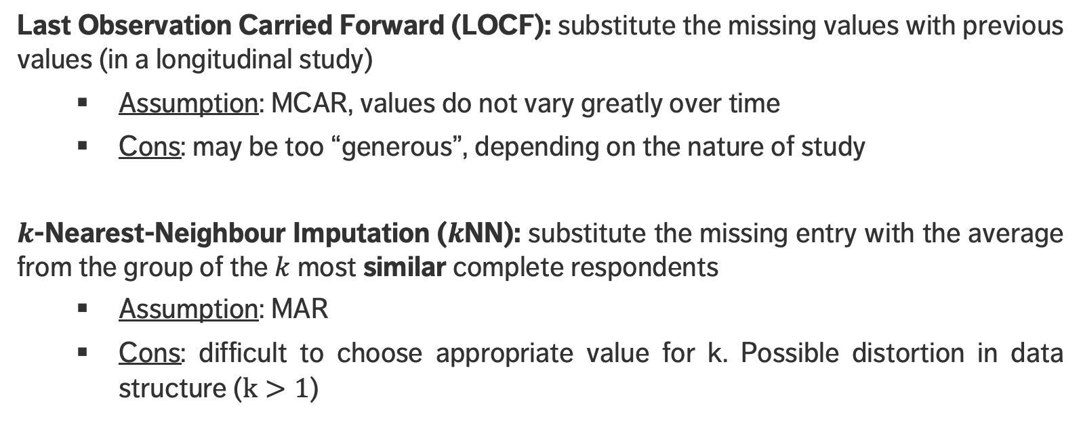
IMPUTATION METHODS
Last Observation Carried Forward (LOCF): substitute the missing values with previous values (in a longitudinal study)
Assumption: MCAR, values do not vary greatly over time
Cons: may be too “generous”, depending on the nature of study
$k$-Nearest-Neighbour Imputation ($k$NN): substitute the missing entry with the average from the group of the $k$ most similar complete respondents
Assumption: MAR
Cons: difficult to choose appropriate value for k. Possible distortion in data structure ($k>1$)

Slide 17
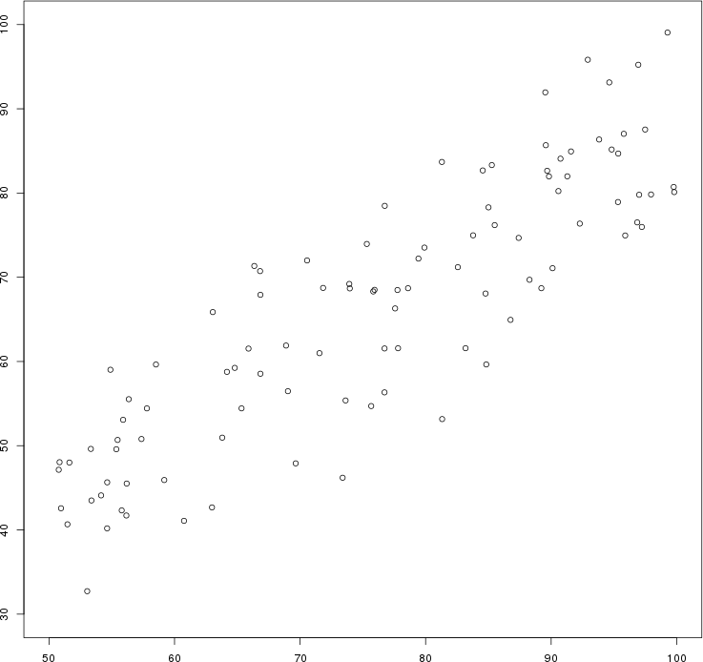
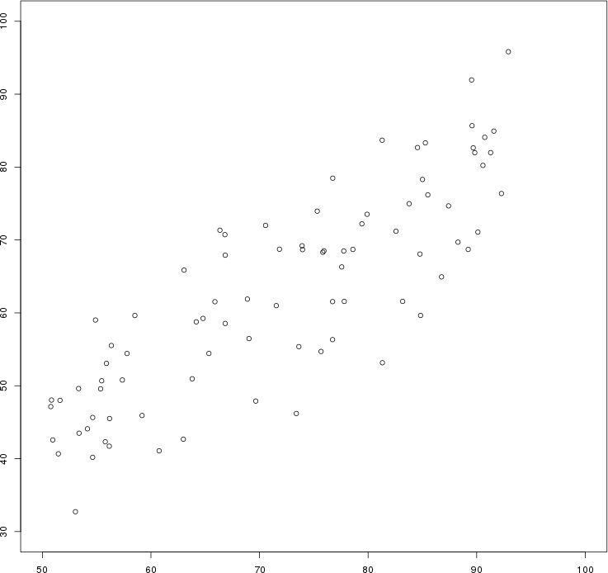
Artificial data: the $y$ values of all points for which $x>92$ have been erased by mistake.
Original Data
List-wise Deletion

Slide 18
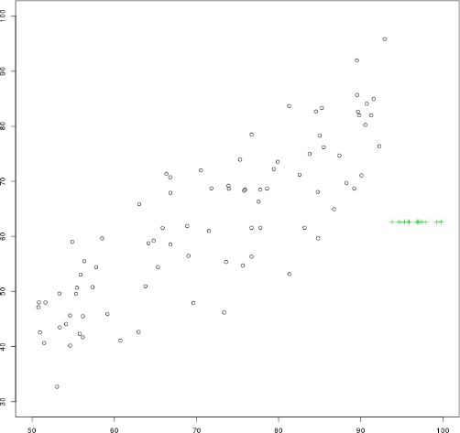
Artificial data: the $y$ values of all points for which $x>92$ have been erased by mistake.
Original Data
Mean Imputation

Slide 19
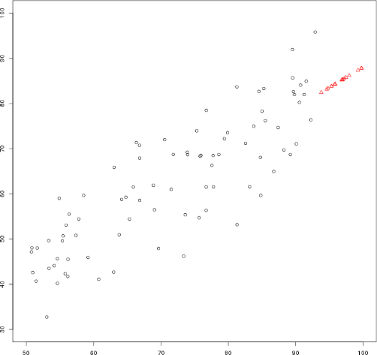
Artificial data: the $y$ values of all points for which $x>92$ have been erased by mistake.
Original Data
Regression Imputation

Slide 20
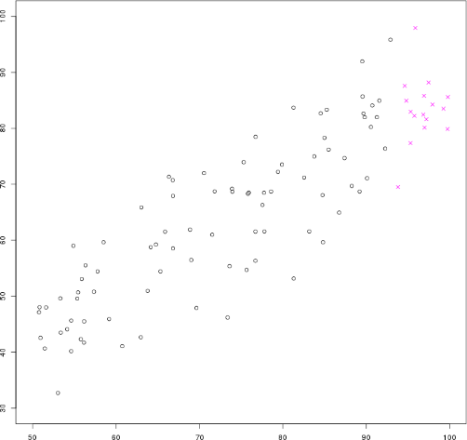
Artificial data: the $y$ values of all points for which $x>92$ have been erased by mistake.
Original Data
Stochastic Regression Imputation

Slide 21
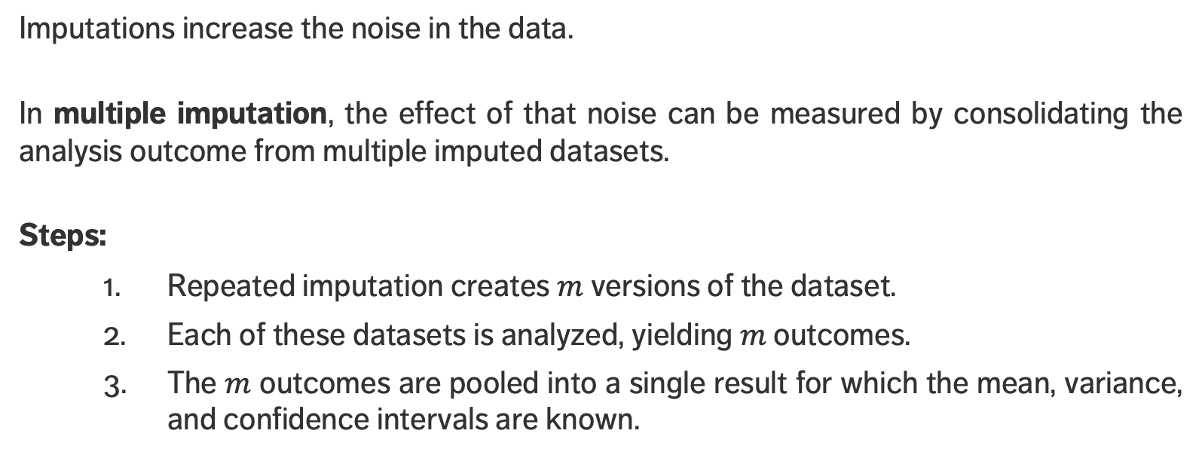
MULTIPLE IMPUTATION
Imputations increase the noise in the data.
In multiple imputation, the effect of that noise can be measured by consolidating the analysis outcome from multiple imputed datasets.
Steps:
Repeated imputation creates $m$ versions of the dataset.
Each of these datasets is analyzed, yielding $m$ outcomes.
The $m$ outcomes are pooled into a single result for which the mean, variance, and confidence intervals are known.

Slide 22
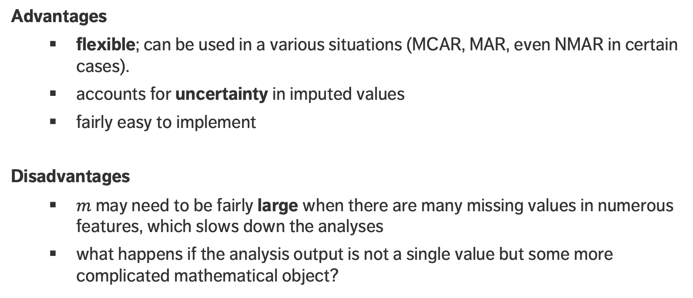
MULTIPLE IMPUTATION
Advantages
flexible; can be used in a various situations (MCAR, MAR, even NMAR in certain cases).
accounts for uncertainty in imputed values
fairly easy to implement
Disadvantages
$m$ may need to be fairly large when there are many missing values in numerous features, which slows down the analyses
what happens if the analysis output is not a single value but some more complicated mathematical object?

Slide 23
TAKE-AWAYS
Missing values cannot simply be ignored.
The missing mechanism cannot typically be determined with any certainty.
Imputation methods work best when values are missing completely at random or missing at random, but imputation methods tend to produce biased estimates.
In single imputation, imputed data is treated as the actual data; multiple imputation can help reduce the noise.
Is stochastic imputation best? In our example, yes – but beware the No-Free Lunch theorem!

Slide 24
SPECIAL DATA POINTS
Outlying observations are data points which are atypical in comparison to
the unit's remaining features (within-unit),
the field measurements for other units (between-units),
or as part of a collective subset of observations.
Outliers are observations which are dissimilar to other cases or which contradict known dependencies or rules.
Careful study is needed to determine whether outliers should be retained or removed from the dataset.

Slide 25
SPECIAL DATA POINTS
Influential data points are observations whose absence leads to markedly different analysis results.
When influential observations are identified, remedial measures (data transformations) may be required to minimize their undue effects.
Outliers may be influential data points, influential points need not be outliers.

Slide 26
DETECTING ANOMALIES
Outliers may be anomalous along any of the unit’s variables, or in combination.
Anomalies are by definition infrequent, and typically shrouded in uncertainty due to small sample sizes.
Differentiating anomalies from noise or data entry errors is hard.
Boundaries between normal and deviating units may be fuzzy.
When anomalies are associated with malicious activities, they are typically disguised.

Slide 27
DETECTING ANOMALIES
Numerous methods exist to identify anomalous observations; none of them are foolproof and judgement must be used.
Graphical methods are easy to implement and interpret.
Outlying Observations box-plots, scatterplots, scatterplot matrices, Cooke's distance, normal qq plots
Influential Data some level of analysis must be performed (leverage)
Once anomalous observations have been removed from the dataset, previously “regular" units may become anomalous.

Slide 28
OUTLIER TESTS
Supervised methods use a historical record of labeled anomalous observations:
domain expertise required to tag the data
classification or regression task (probabilities and inspection rankings)
rare occurrence problem (more on this later)
Unsupervised methods don’t use external information:
traditional methods and tests
can also be seen as a clustering or association rules problem
Semi-supervised methods also exist.

Slide 29
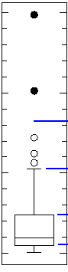
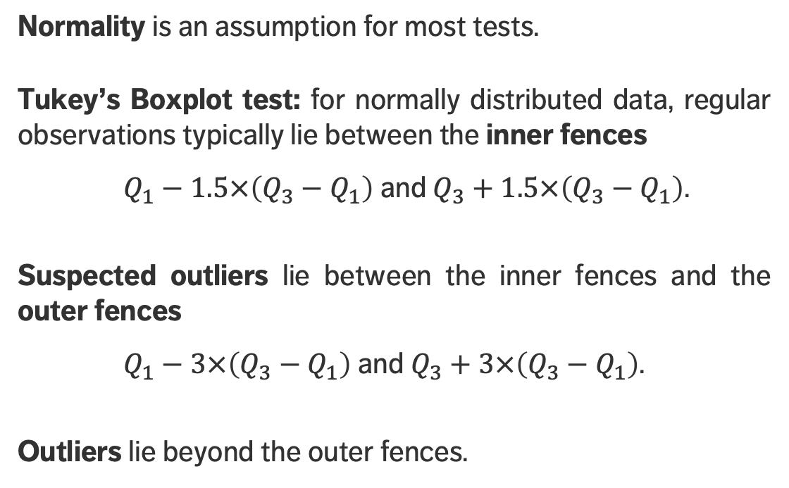
OUTLIER TESTS
Normality is an assumption for most tests.
Tukey’s Boxplot test: for normally distributed data, regular observations typically lie between the inner fences
$Q_{1}−1.5×\left(Q_{3}−Q_{1}\right)$ and $Q_{3}+1.5×\left(Q_{3}−Q_{1}\right)$.
Suspected outliers lie between the inner fences and the outer fences
$Q_{1}−3×\left(Q_{3}−Q_{1}\right)$ and $Q_{3}+3×\left(Q_{3}−Q_{1}\right)$.
Outliers lie beyond the outer fences.
outliers
outer fence
suspected
outliers
inner fence
regular
points

Slide 30
OUTLIER TESTS
Grubbs test used to detect a single outlier
Dixon Q test used to find outliers in (extremely) small datasets (dubious validity)
Mahalanobis distance can be used to find multi-dimensional outliers
Tietjen-Moore test for a specific # of outliers
Generalized extreme studentized deviate test for unknown # of outliers
Chi-square test for outliers affecting goodness-of-fit
DBSCAN, OR_{h} and LOF for unsupervised outlier detection

Slide 31
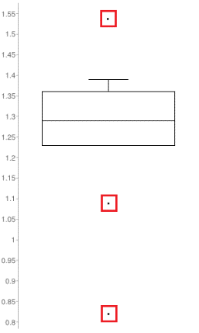
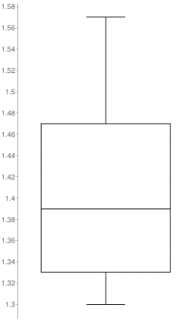
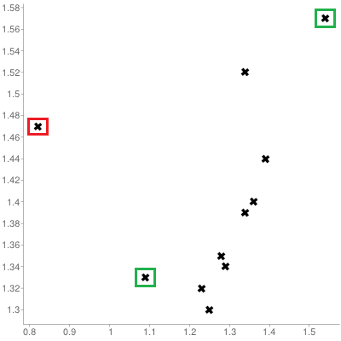
OUTLIERS
[Personal file]
Queuing dataset: processing rate vs. arrival rate

Slide 32
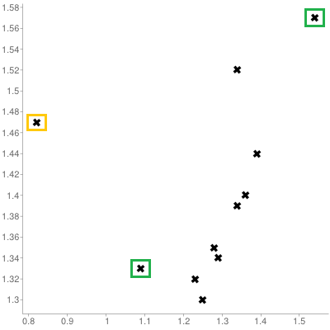
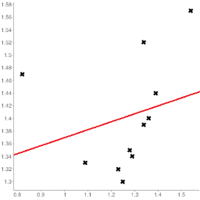
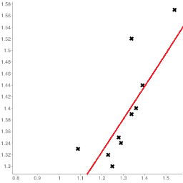
INFLUENTIAL OBSERVATIONS
[Personal file]
Queuing dataset: processing rate vs. arrival rate

Slide 33
TAKE-AWAYS
Identifying influential points is an iterative process as the various analyses have to be run numerous times.
Fully automated identification and removal of anomalous observations is NOT recommended.
Use transformations if the data is NOT normally distributed.
Whether an observation is an outlier or not depends on various factors; what observations end up being influential data points depends on the specific analysis to be performed.

Slide 34
EXERCISE
The ability to monitor and perform early forecasts of various river algae blooms is crucial to control any ecological harm they can cause.
The algae_bloom.csv dataset is used to train a learning model consists of:
chemical properties of various water samples of European rivers
the quantity of seven algae in each of the samples, and
the characteristics of the collection process for each sample.
What is the data science motivation for such a model, given that we can actually analyze water samples to determine if various harmful algae are present or absent?

Slide 35
EXERCISE
The answer is simple: chemical monitoring is cheap and easy to automate, whereas biological analysis of samples is expensive and slow.
Another answer: analyzing the samples for harmful content does not provide a better understanding of algae bloom drivers, it just tells us which samples contain the harmful algae.
Can a model provide a more thorough understanding of the algae situation?

Slide 36
EXERCISE
Locate and determine the structure of the algae bloom dataset and provide a summary of its features.
Compute the number of missing values for each record.
Identify some potential anomalous observations in the same dataset.
What strategies could you use to deal with such observations/records?

Slide 37
DATA REDUCTION AND TRANSFORMATIONS
DATA PROCESSING

Slide 38
DIMENSIONALITY OF DATA
In data analysis, the dimension of the data is the number of variables (or attributes) that are collected in a dataset, represented by the number of columns.
The term dimension is an extension of the use of the term to refer to the size of a vector.
We can think of the variables used to describe each object (row) as a vector describing that object.
Note: the term dimension is used differently in business intelligence contexts.

Slide 39
But more data is always better, right?
It depends.

Slide 40
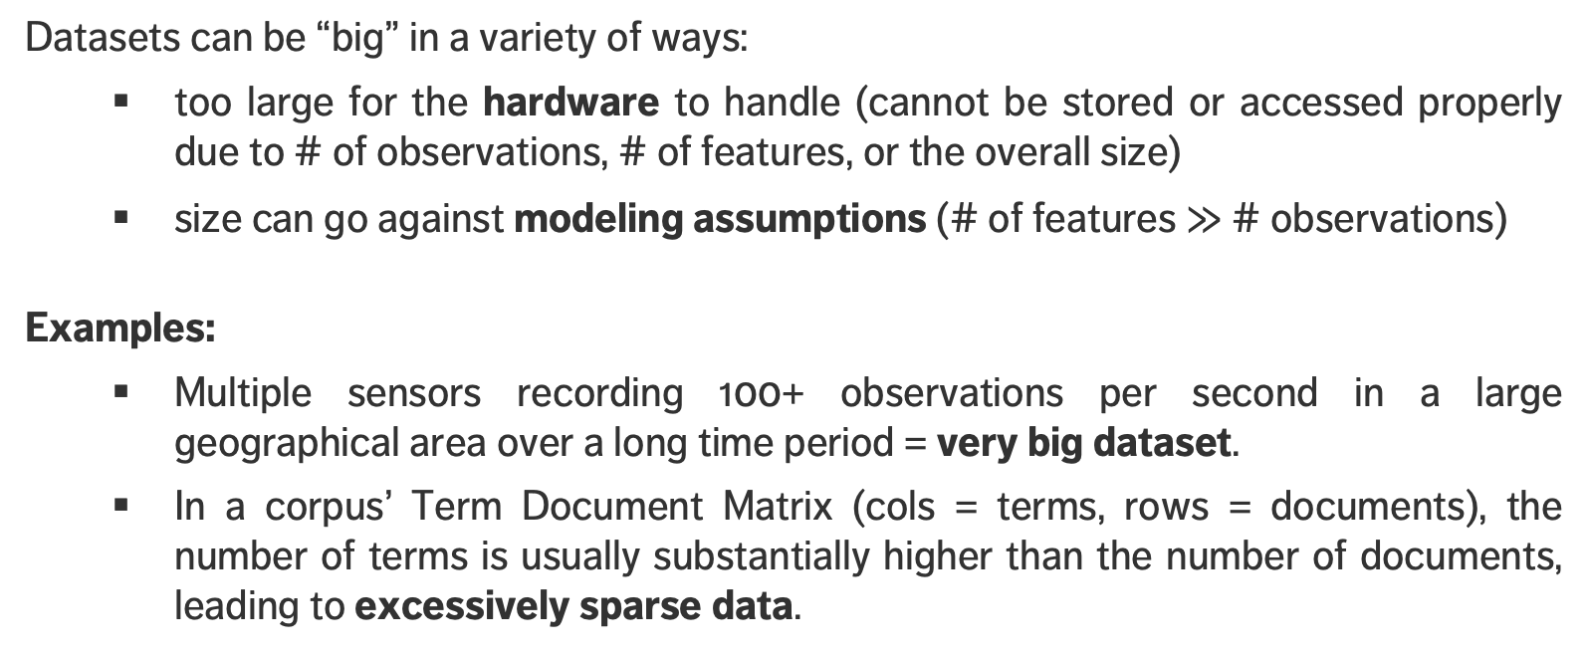
HIGH DIMENSIONALITY & BIG DATA
Datasets can be “big” in a variety of ways:
too large for the hardware to handle (cannot be stored or accessed properly due to # of observations, # of features, or the overall size)
size can go against modeling assumptions (# of features $≫$ # observations)
Examples:
Multiple sensors recording 100+ observations per second in a large geographical area over a long time period = very big dataset.
In a corpus’ Term Document Matrix (cols = terms, rows = documents), the number of terms is usually substantially higher than the number of documents, leading to excessively sparse data.

Slide 41
CURSE OF DIMENSIONALITY
Unless the dataset size grows exponentially with its dimension, the performance of any model we build is likely to suffer due to the Curse of Dimensionality.
Possible solutions:
sampling observations
feature selection (easy-ish) and/or dimension reduction (hard).
We look for ways to preserve the signal while shrinking the dimension: it’s easier to find needles in small haystacks!
(This is actually a thorny problem… but we’ll avoid the technical details in this course).

Slide 42
SAMPLING OBSERVATIONS
Question: does every observation (row of the dataset) need to be used?
If rows are selected randomly, the resulting sample might be representative of the entire dataset.
Drawbacks:
if the signal of interest is rare, sampling might drown it altogether
if aggregation is happening down the road, sampling will necessarily affect the numbers (passengers vs. flights)
even simple operations on a large file (finding the # of lines, say) can be taxing on the memory and in terms of computation time – prior information on the dataset structure can help

Slide 43
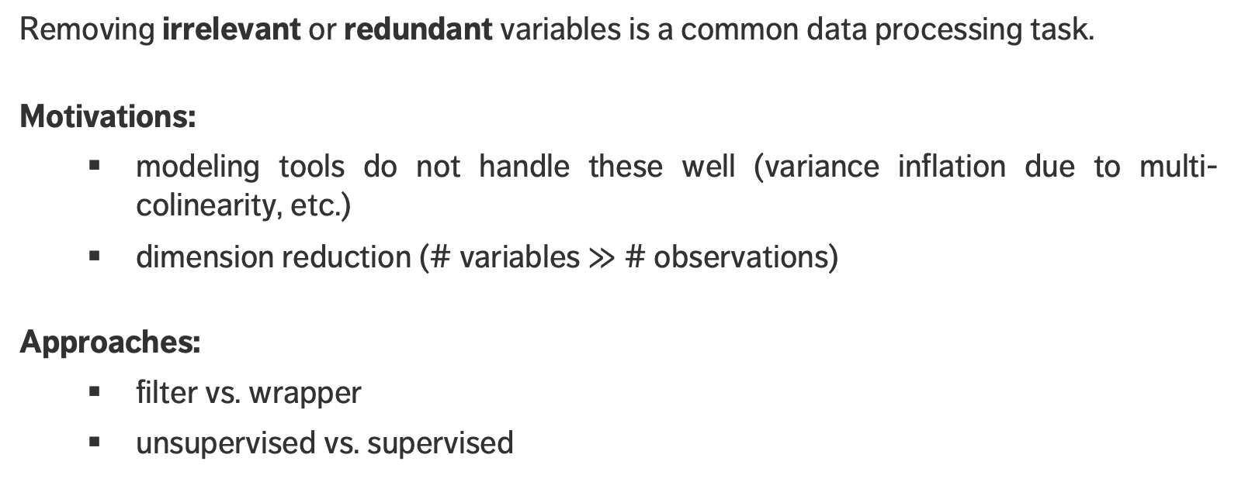
FEATURE SELECTION
Removing irrelevant or redundant variables is a common data processing task.
Motivations:
modeling tools do not handle these well (variance inflation due to multi-colinearity, etc.)
dimension reduction (# variables $≫$ # observations)
Approaches:
filter vs. wrapper
unsupervised vs. supervised

Slide 44
FEATURE SELECTION METHODS
Filter methods inspect each variable individually and score them according to some importance metric.
The less relevant features (i.e. importance score below some set threshold) are then removed.
Wrapper methods seek feature subsets for which the evaluation criterion used by the eventual analytical method is “optimized”.
The process is iterative, and typically computationally intensive: candidate subsets are used in the analysis until one produces an acceptable evaluation metric for the analysis.

Slide 45
FEATURE SELECTION METHODS
Unsupervised methods determine the importance of a feature based only on its values.
Supervised methods evaluate each feature’s importance by studying the relationship with a target feature (correlation, etc.)
Wrapper methods are usually supervised.
Unsupervised filter methods: removing constant variables, ID-like variables (different on all observations), features with low variability, etc.

Slide 46
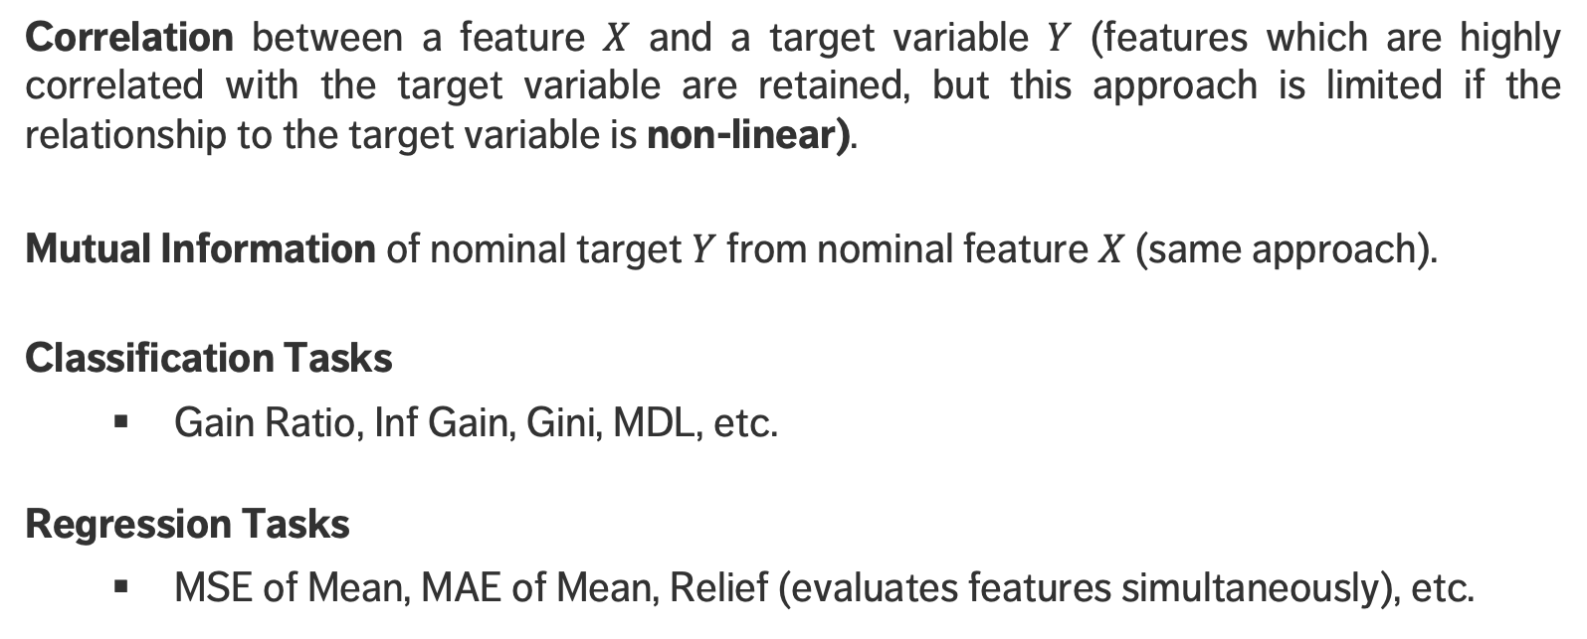
SUPERVISED FILTER METHODS
Correlation between a feature $X$ and a target variable $Y$ (features which are highly correlated with the target variable are retained, but this approach is limited if the relationship to the target variable is non-linear).
Mutual Information of nominal target $Y$ from nominal feature $X$ (same approach).
Classification Tasks
Gain Ratio, Inf Gain, Gini, MDL, etc.
Regression Tasks
MSE of Mean, MAE of Mean, Relief (evaluates features simultaneously), etc.

Slide 47
COMMON TRANSFORMATIONS
Models sometimes require that certain data assumptions be met (normality of residuals, linearity, etc.).
If the raw data does not meet the requirements, we can either
abandon the model
attempt to transform the data
The second approach requires an inverse transformation to be able to draw conclusions about the original data.

Slide 48
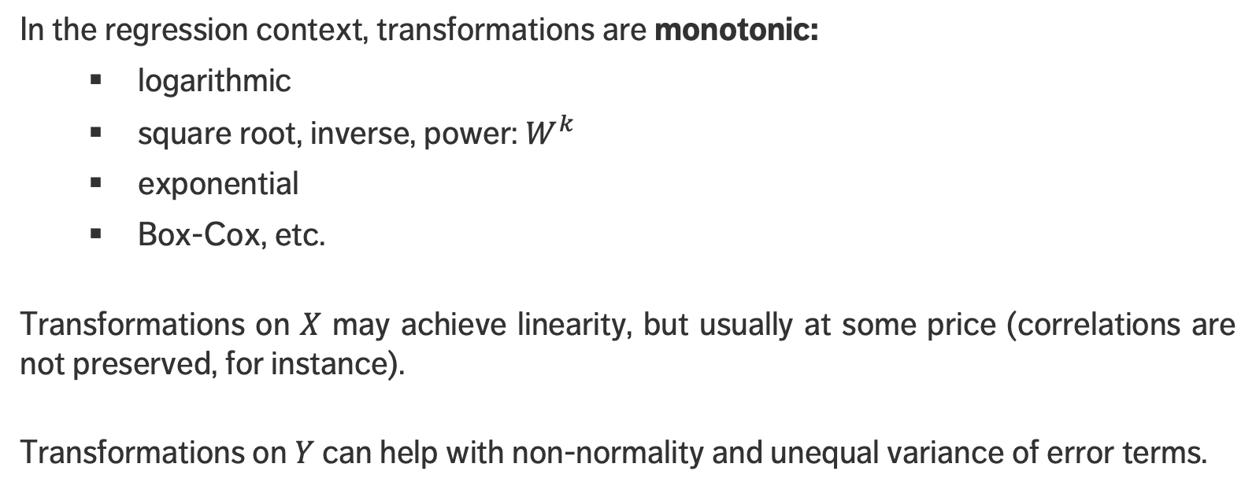
COMMON TRANSFORMATIONS
In the regression context, transformations are monotonic:
logarithmic
square root, inverse, power: $W^{k}$
exponential
Box-Cox, etc.
Transformations on $X$ may achieve linearity, but usually at some price (correlations are not preserved, for instance).
Transformations on $Y$ can help with non-normality and unequal variance of error terms.

Slide 49
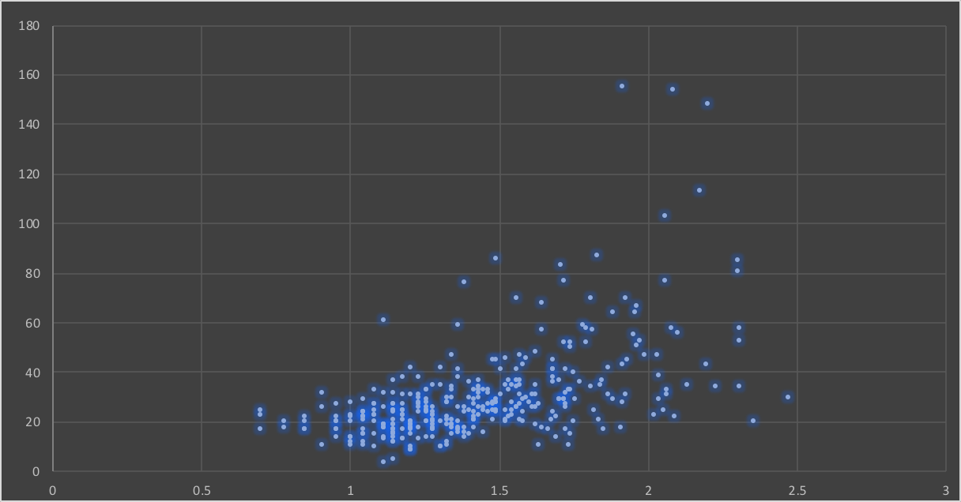
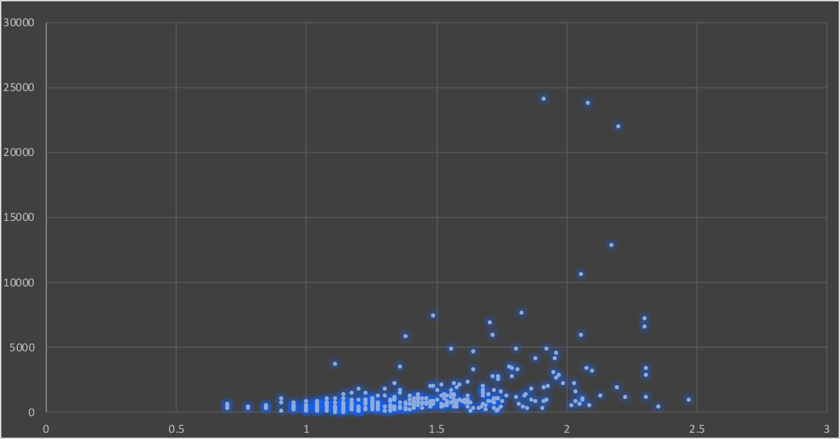
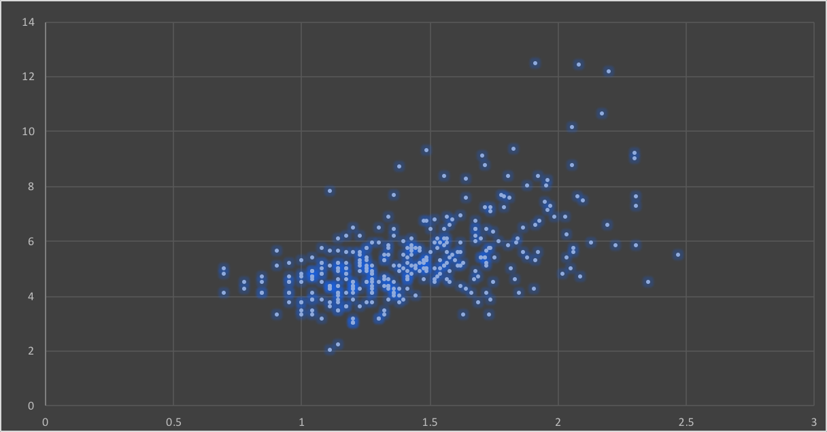
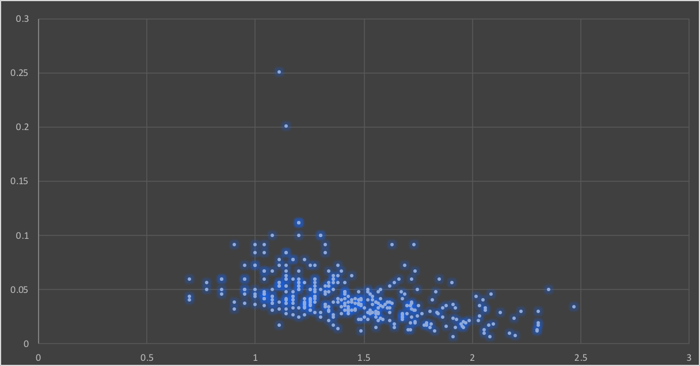
Original Data
Square
Square Root
Reciprocal

Slide 50
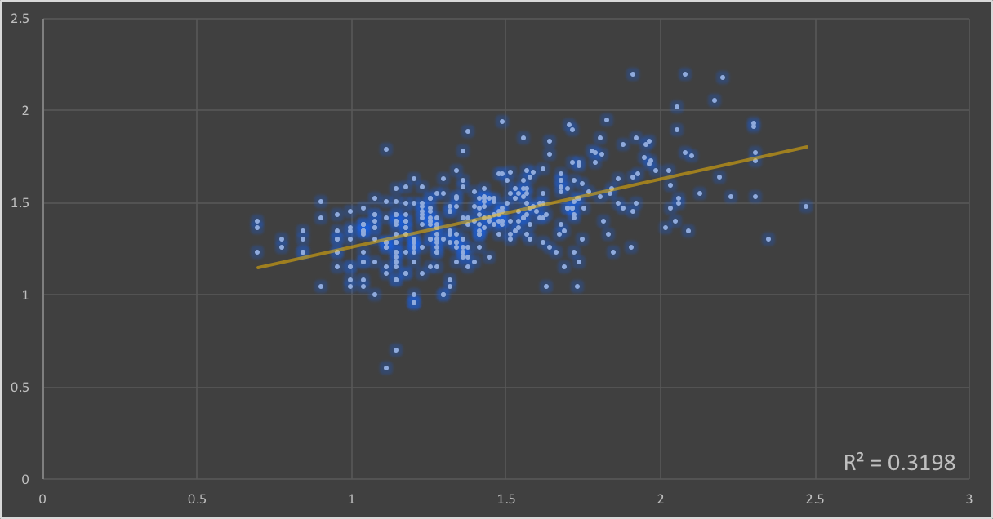
Logarithm (Box-Cox)

Slide 51
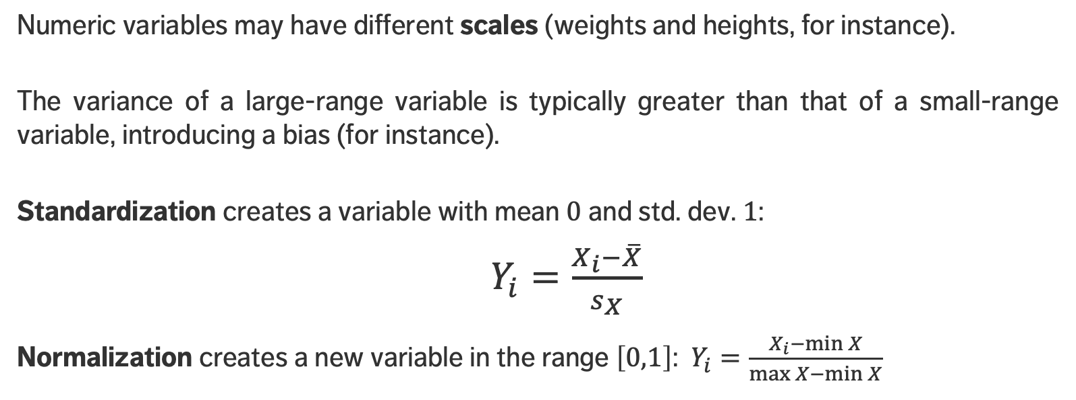
SCALING
Numeric variables may have different scales (weights and heights, for instance).
The variance of a large-range variable is typically greater than that of a small-range variable, introducing a bias (for instance).
Standardization creates a variable with mean $0$ and std. dev. $1$:
$Y_{i}=\frac{X_{i}−\overline{X}}{s_{X}}$
Normalization creates a new variable in the range $\left[0,1\right]$: $Y_{i}=\frac{X_{i}−\min{X}}{\max{X−\min{X}}}$

Slide 52
DISCRETIZING
To reduce computational complexity, a numeric variable may need to be replaced by an ordinal variable (from height value to “short”, “average”, “tall”, for instance).
Domain expertise can be used to determine the bins’ limits (although that could introduce unconscious bias to the analyses)
In the absence of such expertise, limits can be set so that either
the bins each contain the same number of observations
the bins each have the same width
the performance of some modeling tool is maximized

Slide 53
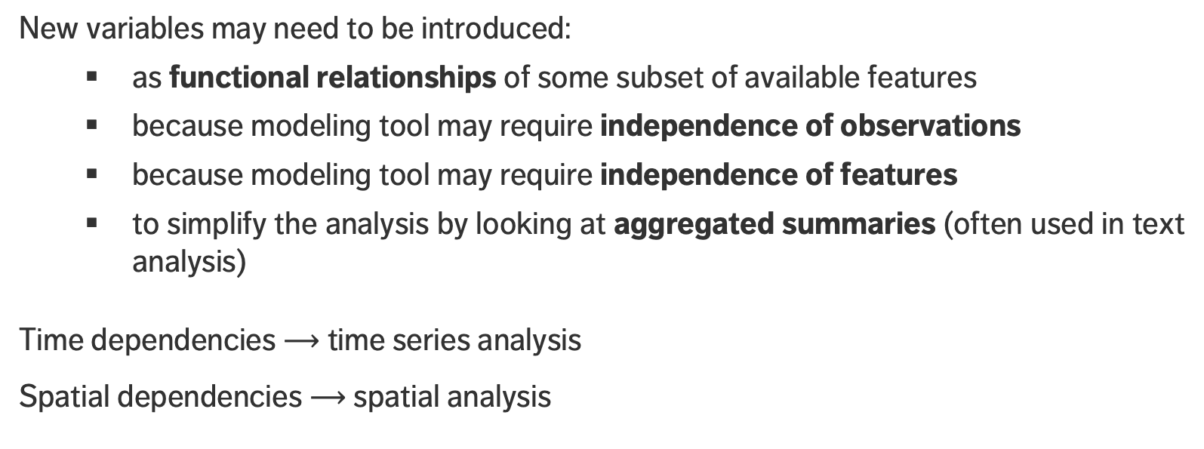
CREATING VARIABLES
New variables may need to be introduced:
as functional relationships of some subset of available features
because modeling tool may require independence of observations
because modeling tool may require independence of features
to simplify the analysis by looking at aggregated summaries (often used in text analysis)
Time dependencies $⟶$ time series analysis
Spatial dependencies $⟶$ spatial analysis

Slide 54
DATA QUALITY AND DATA VALIDATION
DATA PROCESSING
Martin: Data is messy.
Allison: Even when it’s been cleaned?
Martin: Especially when it’s been cleaned.
P. Boily, Introduction to Quantitative Consulting

Slide 55
SOUND DATA
The ideal dataset will have as few issues as possible with:
Validity: data type, range, mandatory response, uniqueness, value, regular expressions
Completeness: missing observations
Accuracy and Precision: related to measurement and/or data entry errors; target diagrams (accuracy as bias, precision as standard error)
Consistency: conflicting observations
Uniformity: are units used uniformly throughout?
Checking for data quality issues at an early stage can save headaches later in the analysis.

Slide 56

SOUND DATA
accurate and precise
precise but not accurate
accurate but not precise
neither accurate nor very precise

Slide 57
COMMON SOURCES OF ERROR
When dealing with legacy, inherited or combined datasets (that is, datasets over which you have little control):
missing data given a code
‘NA’/‘blank’ given a code
data entry error
coding error
measurement error
duplicate entries
heaping

Slide 58
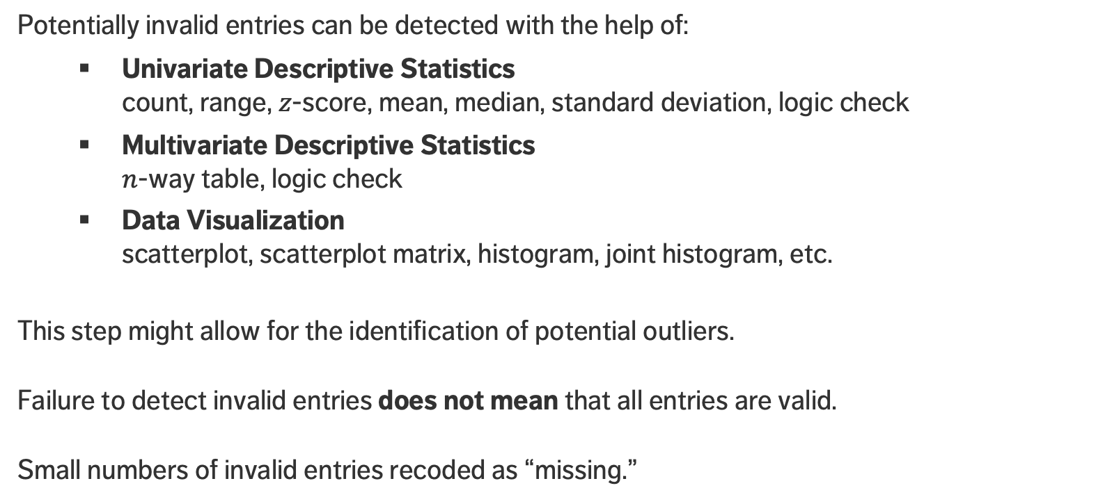
DETECTING INVALID ENTRIES
Potentially invalid entries can be detected with the help of:
Univariate Descriptive Statistics count, range, $z$-score, mean, median, standard deviation, logic check
Multivariate Descriptive Statistics $n$-way table, logic check
Data Visualization scatterplot, scatterplot matrix, histogram, joint histogram, etc.
This step might allow for the identification of potential outliers.
Failure to detect invalid entries does not mean that all entries are valid.
Small numbers of invalid entries recoded as “missing.”
Notes:
Email story? Smart phone story?

Slide 59
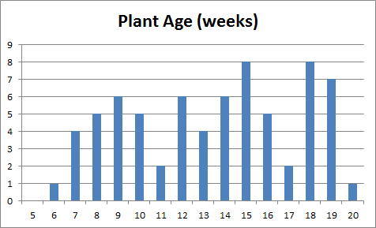
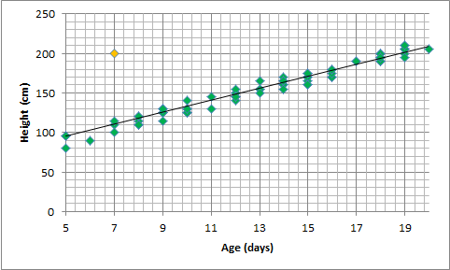
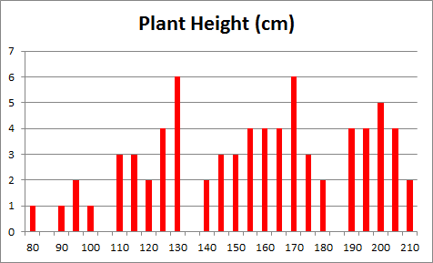
ILLUSTRATION
[Personal file]

Slide 60
ILLUSTRATION
[Personal file]
Time of arrivals at screening station, prior to departure (mins)

Slide 61
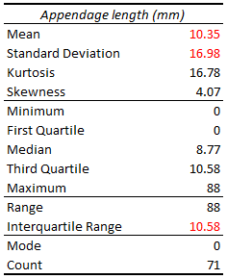
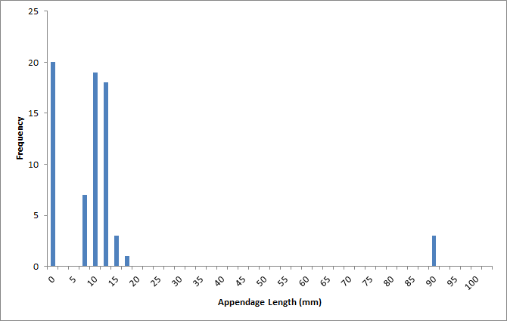
ILLUSTRATION
[Personal file]

Slide 62
TAKE-AWAYS
Don't wait until after the analysis to find out there was a problem with data quality.
Univariate tests don’t always tell the whole story.
Visualizations can help.
Context is crucial – you may need more context about the data in order to make sense of what you see… but whatever the situation, you need to understand the dataset quality.

